Slide 1

GLOBAL STARTUP & INVESTMENT
INTELLIGENCE PLATFORM
A Power BI-Driven Platform for Analyzing Startup Ecosystems, Funding Trends,
Venture Capital Investments, Acquisitions, and IPO Performance
$413B+
196,553
175
52,928
FUNDING TRACKED
STARTUPS
COUNTRIES
FUNDING ROUNDS
Crunchbase Startup Investment Dataset | Power BI · Power Query · DAX

Slide 2




Executive Summary
The Global Startup & Investment Intelligence Platform is a business intelligence solution that brings together startup profiles, funding rounds, investor activity, acquisitions, and IPO outcomes into one interactive Power BI environment.
Instead of leaving investors, founders, and analysts to piece together fragmented spreadsheets, the platform converts millions of raw investment records into clear, explorable dashboards — surfacing which sectors attract the most capital, how funding behaves over time, and where global startup activity is concentrated.
$413B+
196,553
Total Funding Tracked
Startups Analyzed
52,928
175
Funding Rounds
Countries Covered
Global Startup & Investment Intelligence Platform
2

Slide 3

The Problem & Our Objectives
Project Objectives
Why This Matters
1
Analyze startup funding and investment activity across industries
Startup investment has exploded over the last decade, attracting billions of dollars across thousands of companies. Yet the data describing that activity is scattered across funding announcements, investor records, and exit filings.
Stakeholders are often left guessing which sectors are genuinely growing, which regions are pulling in capital, and how startups actually perform once funded — making it hard to evaluate opportunities or make informed decisions.
2
Identify top-performing sectors and regions
3
Understand venture capital investment behavior
4
Evaluate startup exits through acquisitions and IPOs
5
Build an interactive intelligence platform using Power BI
Global Startup & Investment Intelligence Platform
3

Slide 4





Data Sources & Scope
Crunchbase Startup Investments dataset — five linked tables covering the full startup lifecycle
objects.csv
Startup & company profiles
196,553 companies
funding_rounds.csv
Funding round details & amounts
52,928 rounds
investments.csv
Investor – startup relationships
80,903 records
acquisitions.csv
Acquisition transactions & exits
9,562 acquisitions
ipos.csv
IPO details & valuations
1,259 IPOs
Coverage spans 175 countries and multiple industries and funding stages — from first investment through acquisition or IPO.
Global Startup & Investment Intelligence Platform
4

Slide 5




Methodology
1
2
3
4
5
Data Collection
Data Cleaning
Transformation
EDA
Dashboard Build
Import the five Crunchbase datasets into Power BI
Remove duplicates, handle missing values, standardize countries & categories
Build funding categories, startup age groups, and KPI measures
Growth, funding trend, investor activity, geographic & exit analysis
Interactive visuals, KPI cards, maps, filters, drill-through
Global Startup & Investment Intelligence Platform
5

Slide 6
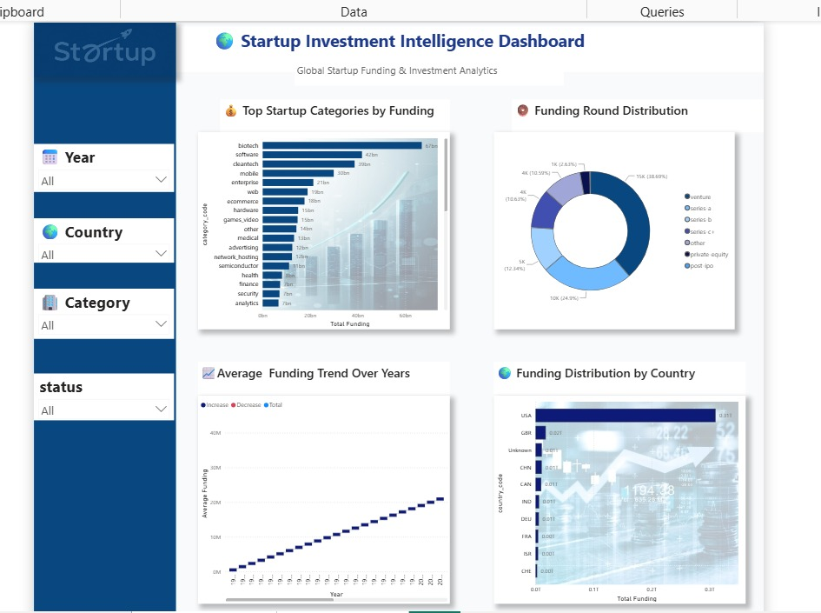

Dashboard Showcase
Startup Investment Intelligence Dashboard — Power BI
Category Leaders
Biotech, software & cleantech draw the most capital across all sectors tracked.
Round Mix
Venture and Series A rounds account for the bulk of all funding events.
Steady Climb
Average funding per round trends upward year over year.
Global Reach
The USA leads funding volume, with the UK, China & India following.
Global Startup & Investment Intelligence Platform
6

Slide 7
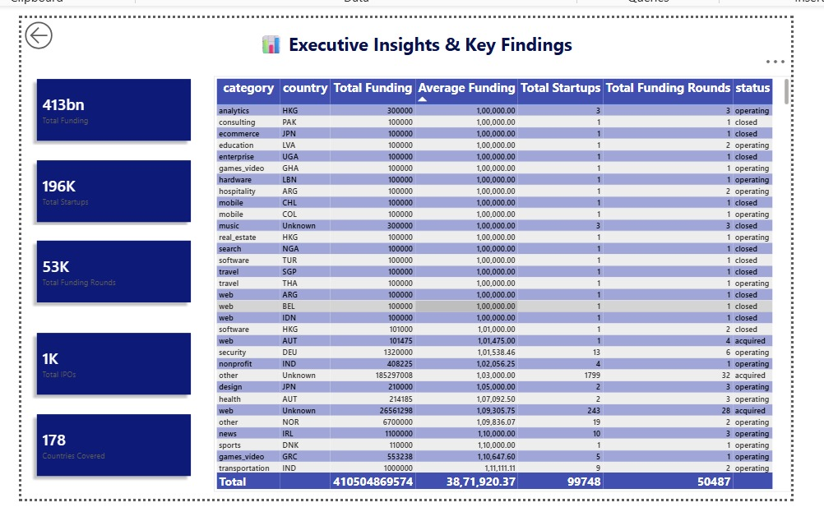

Dashboard Showcase
Executive Insights & Key Findings — Power BI
Reading the Table
The drill-through page breaks every KPI down by category and country, ranking combinations by total funding, average ticket size, startup count, round volume, and operating status — letting analysts move from the headline numbers straight to the segment driving them.
Status segmentation: operating, acquired, closed, and IPO are tracked side by side for every record.
$413B
196K
53K
1K
175
FUNDING
STARTUPS
ROUNDS
IPOS
COUNTRIES
Global Startup & Investment Intelligence Platform
7

Slide 8
Key Insights from the Data
Computed directly from the underlying Crunchbase records
Top Categories by Total Funding ($B)
Top Countries by Total Funding ($B)
Global Startup & Investment Intelligence Platform
8

Slide 9










Tools, Technologies & Advanced Features
Core Tools
Advanced Power BI Features
KPI Cards
Dynamic Titles
Drill Through
Power BI
Power Query
DAX
Tooltips
Bookmarks
Smart Narrative
Microsoft Excel
CSV Data Sources
SQL (optional)
Decomposition Tree
Geographic Maps
Interactive Slicers
Global Startup & Investment Intelligence Platform
9

Slide 10

Conclusion & Expected Outcomes
Interactive Power BI dashboards with multiple analytical views
Clear identification of top-performing industries and countries
Actionable insights into venture capital investment trends
Startup growth and funding pattern analysis
Acquisition and IPO performance monitoring
Investor activity and participation analysis
Turning 413,000+ data points into a clear, data-driven view of how the world funds innovation — enabling investors, founders, and analysts to make smarter, faster decisions.
Global Startup & Investment Intelligence Platform
10

